Slide 1




HTML Blocks
Class: 8
Lab : 22

Slide 2




Elements
Every HTML element has a default display value depending on what type of element it is. The default display value for most elements is block or inline.

Slide 3
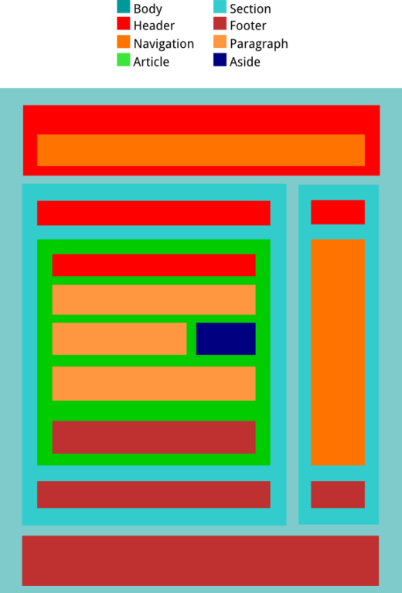
Block-level Elements
A block-level element always starts on a new line and takes up the full width available

Slide 4
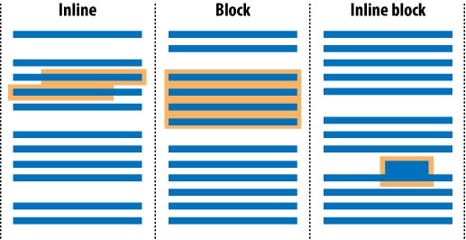
Inline Elements
An inline element does not start on a new line and
only takes up as much width as necessary

Slide 5
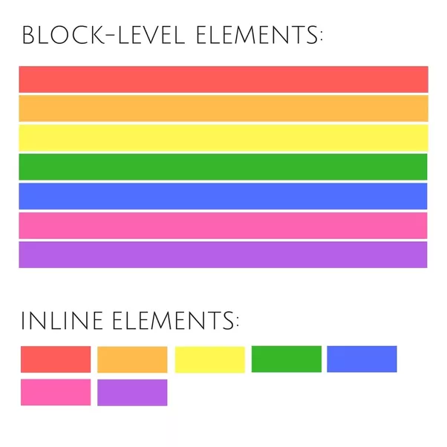
Block vs Inline

Slide 6
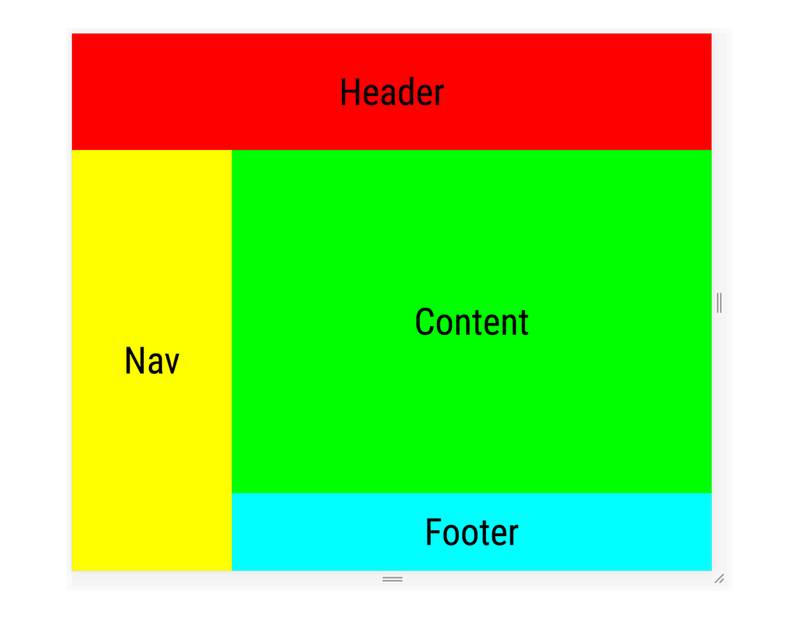
The <div> Element
The <div> element is often
used as a container for other
HTML elements. When used
together with CSS, the <div>
element can be used to style
blocks of content

Slide 7



